Slide 1
Public Key Infrastructure
Use of digital signatures in information security
Mihai-Lica Pura
2020.03.18

Slide 2
Topics
Information security
Cryptography and its use for accomplishing the goals of information security:
Authentication
Confidentiality
Integrity
Non-repudiation
Electronic signatures vs. digital signatures

Slide 3
Topics
Symmetric cryptography
Problem with sharing the key between the parties
Asymmetric cryptography
Problem with trusting that a given public key belongs to a certain entity (person, server)
Speed problem
Solving the speed problem
Asymmetric cryptography for confidentiality
Hybrid cryptography

Slide 4
Topics
Solving the trust problem
Public Key Infrastructure
Certificate issuance flow
Trust flow
Web of trust (PGP)
Same as above
Identity based cryptography
Same as above

Slide 5
Topics
Public Key Infrastructure
Certificate issuance in PKI
PKCS#12, PEM, DER, X509 v3, ASN.1, OID
Management of certificates in Microsoft Windows
Windows certificate stores, certmgr.msc, mc.exe
Validation of a certificate
Time validity
Revocation status
Trust
Certificate trust path
Self-signed CA certificates
Microsoft Trusted Root Certificate Program
Mozilla CA Certificate Policy

Slide 6
Topics
Certificate revocation
CRL, OCSP
Certificate search
CA web page manual search, LDAP
Performing a digital signature
Using Microsoft CNG API through certificate stores
flow
Using PKCS#11
flow
Remote/cloud/mobile through Cloud Signature Consortium signing protocol
flow

Slide 7
Topics
E-signature vs. e-seal
Use of digital signed documents
ANAF
CNAS
ONRC
UNNPR
ITM
MySMIS 2014
MO
etc.

Slide 8
Topics
Digital signing documents
Qualified Electronic Signatures
PDF (Adobe Acrobat Reader)
Signing PDF files
Signing PDF forms with a digital signature field
Microsoft Office documents (Microsoft Office software)
PKCS#7 (DeskSeal, Prosigner, etc.)
Attached, detached, cosignatures
XMLDSig
Advanced Electronic Signatures
CAdES, PAdES, XAdES
Time stamping of digital signatures

Slide 9
Topics
Digital signing code
Java applets (obsolete)
Java Web Start (signed jars for JNLP)
Macros (Microsoft Office)
Microsoft software installation packages
Digital signing for authentication
Certificate login
Cryptography APIs
High level
low level

Slide 10
The trust problem
Asymmetric key cryptography based on two keys:
a public key known to anybody,
a private key known only by the owner of the pair
the two keys are in a mathematical relation
How to be sure that a public key really belongs to a certain person or entity?
Solutions:
Based on certificates
1. Public Key Infrastructure
2. Web of Trust
Certificateless
Identity based Cryptography

Slide 11
The trust problem
PKI solution
The public key is bounded to the identity of the owner through a Certificate Authority (CA)
The CA guarantees the identity of the owner of the public key
The element that securely proves this bound is the digital certificate

Slide 12
Public Key Infrastructure
PKI
set of components (hardware and software) that work together for using public-key technology in a secure manner
Components of a PKI
The end-entities (EE)
The certificate authority (CA)
The certificate repository (CR)
The registration authority (RA)
Digital certificates

Slide 13
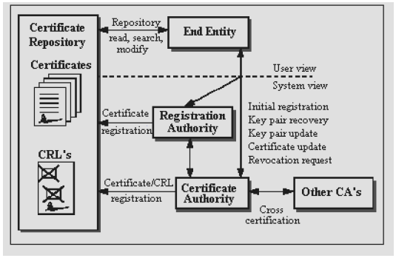
Public Key Infrastructure

Slide 14
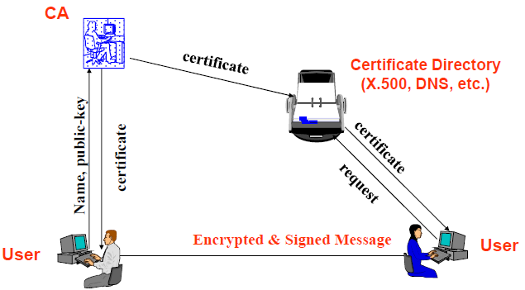
Public Key Infrastructure

Slide 15
End-entity
is defined as a user of PKI certificate and/or end-user system that is the subject of a certificate
is a generic term for a subject that uses some services or functions of the PKI system, which may be
a certificate owner (human being or organization or some other entities)
a requestor (it might be application program) for certificate or CRL

Slide 16
Certificate Authority
CA
a trusted authority
central administration
provides a statement (the digital certificate) that the enclosed public key belongs to the specified entity
organization/company to its employees
university to its students
public CAs to their clients
Primary operations
certificate issuance
certificate renewal
certificate revocation

Slide 17
Certificate Authority
Original intent was to certify that a public key really did belong to a given entity
Role was later expanded to certify all sorts of other things
Are they a bona fide business?
Can you trust their web server?
Can you trust the code they write?
Is their account in good standing?
Are they over 18?

Slide 18
Certificate Authority Hierarchy
Each CA issues certificates to its users community
Root-CA is used to establish TRUST between communities
Root certificates (self-signed) are installed/configured as trusted points

Slide 19
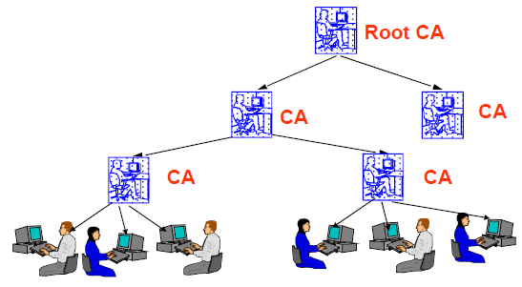
Certificate Authority Hierarchy

Slide 20
Registration Authority
An optional component in a PKI
The CA can incorporate the role of an RA
When used, the RA is
a trusted end-entity certified by the CA
acting as a subordinate server of the CA
The CA can delegate some of its management functions to the RA
personal authentication tasks
generate keys
archive key pairs
The RA, however, does not issue certificates or CRLs

Slide 21
Certificate Repository
Store for certificates and CRLs
X.509 certificate format fit to an X.500 directory
Best implemented as a directory accessed by Lightweight Directory Access Protocol (LDAP)
CR can be accessed with LDAP commands or procedures (bind, search, modify, unbind)

Slide 22
How to obtain a digital certificate (qualified)
http://www.transsped.ro/
http://ca.transsped.ro/Index.aspx?Document=enrol
http://ca.transsped.ro/Index.aspx?Document=UA_Form

Slide 23
Free digital certificates
Getting a free S/MIME digital certificate (personal)
http://kb.mozillazine.org/Getting_an_SMIME_certificate
Getting a free SSL/TLS digital certificate (server)
https://geekflare.com/free-ssl-tls-certificate/

Slide 24
Free digital certificates (S/MIME)
SECTIGO (formerly COMODO CA)
https://www.instantssl.com/ssl-certificate-products/free-email-certificate.html
Actalis
https://www.actalis.it/products/certificates-for-secure-electronic-mail.aspx

Slide 25
Free digital certificates (S/MIME)
WoSign
https://www.wosign.com/english/Free_Email_Certificate.htm
GlobalSign
https://www.globalsign.com/en/personalsign/
secorio
https://www.secorio.com/en/?S_MIME_Email_Certificates

Slide 26
Free digital certificates (S/MIME)
Tutorials – COMODO
https://fastersolutions.com/wp-lib/wp-content/uploads/2015/07/comodoinstructions.pdf
https://support.postbox-inc.com/hc/en-us/articles/202200540-Obtaining-an-S-MIME-Certificate-to-Sign-Emails
https://www.netwoven.com/2015/07/07/secure-encrypt-emails-in-outlook-with-a-digital-id-certificate/

Slide 27
Free digital certificates (SSL/TLS)
COMODO
https://ssl.comodo.com/free-ssl-certificate.php
Let’s encrypt
https://letsencrypt.org/
https://www.sslforfree.com/
ZeroSSL
https://zerossl.com/

Slide 28
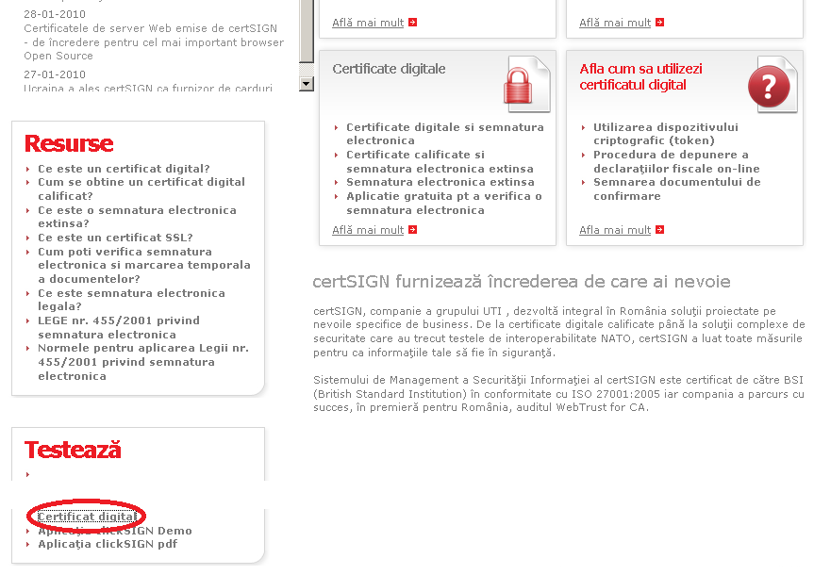
How to obtain a digital certificate (for testing)
https://www.certsign.ro

Slide 29
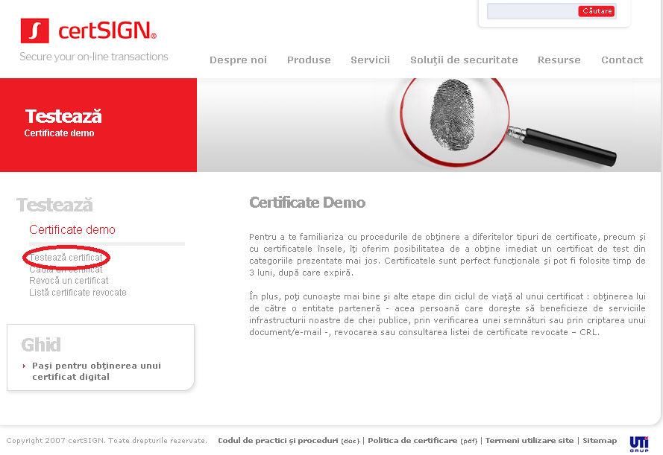
How to obtain a digital certificate

Slide 30
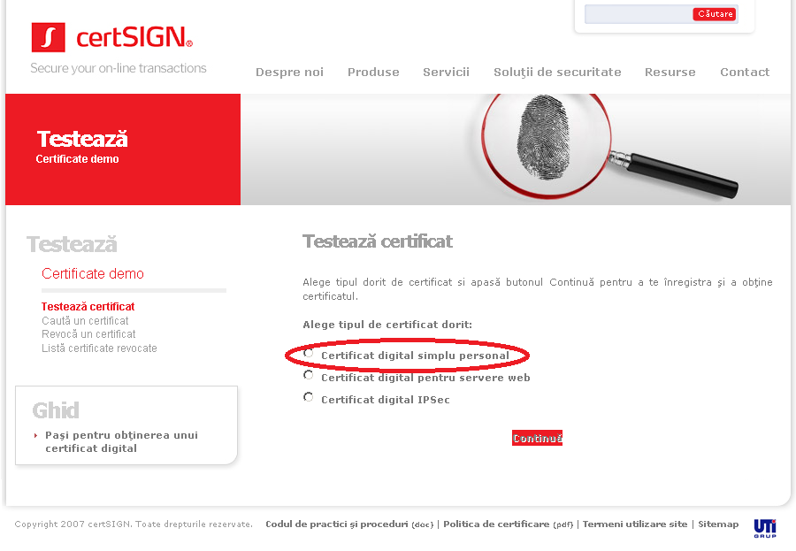
How to obtain a digital certificate

Slide 31
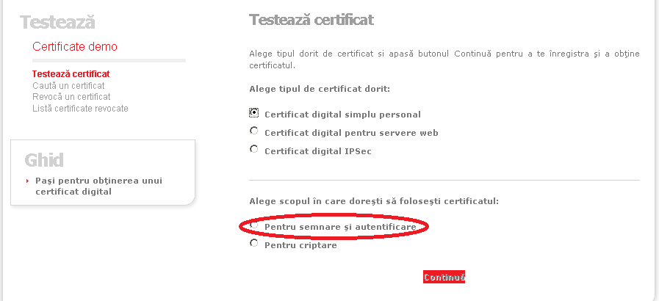
How to obtain a digital certificate

Slide 32
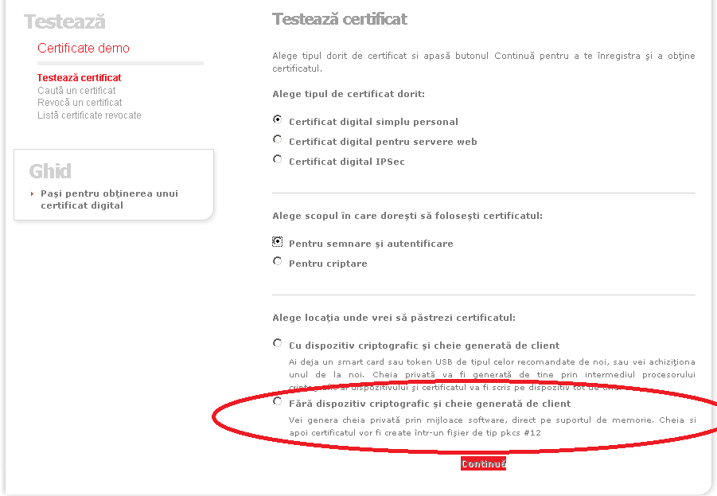
How to obtain a digital certificate

Slide 33
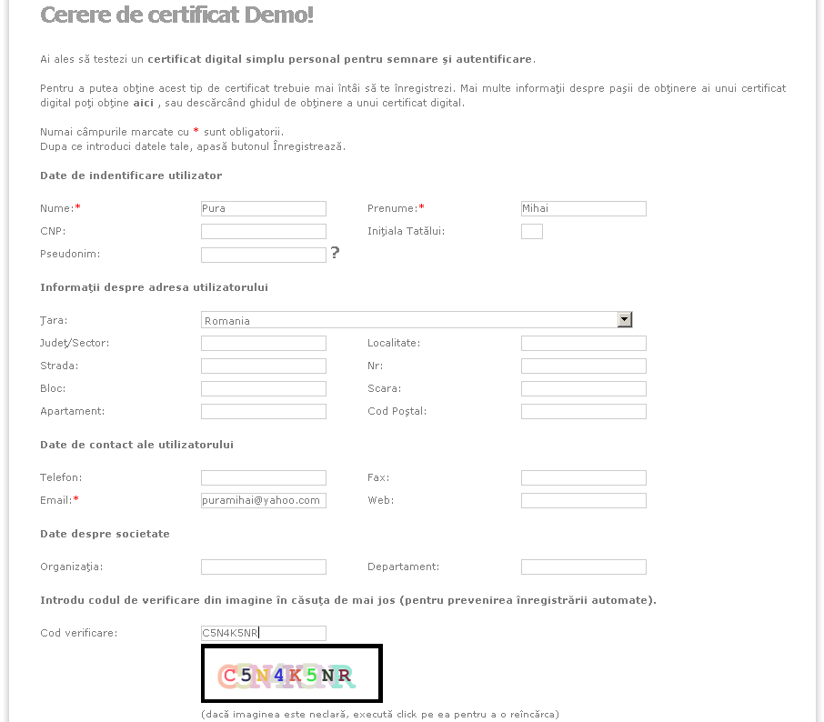
How to obtain a digital certificate

Slide 34
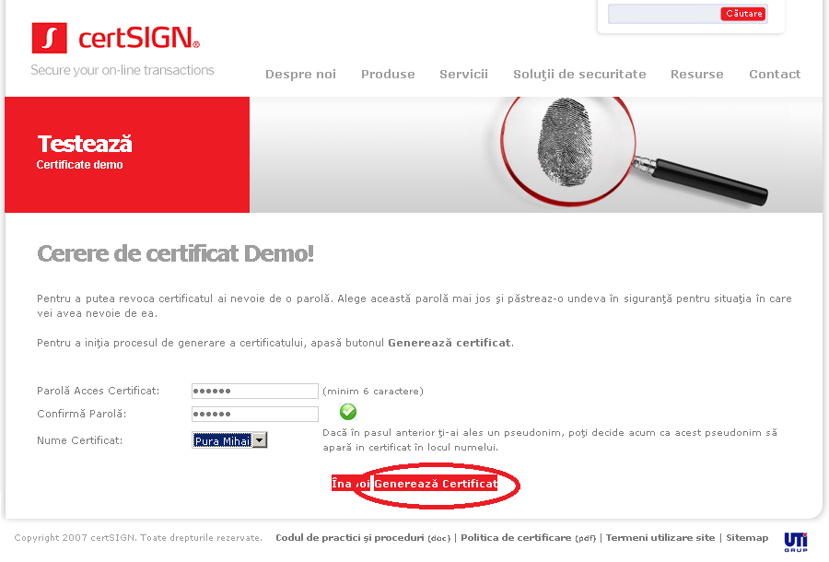
How to obtain a digital certificate

Slide 35
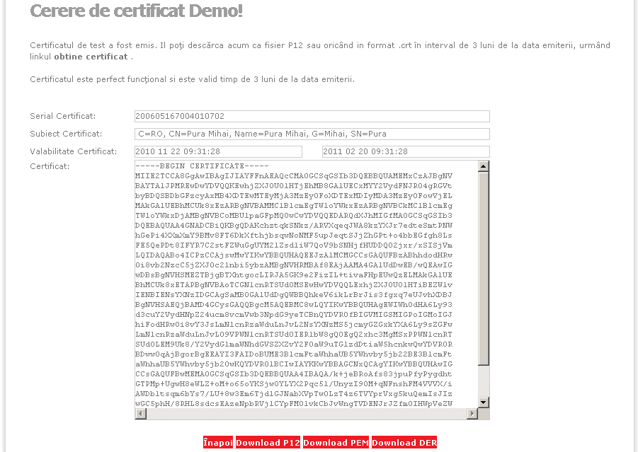
How to obtain a digital certificate

Slide 36
P12
P12 - PKCS#12 - Public Key Cryptography Standards 12 –
RSA Laboratories standard
defines the format of the files used to store a private key together with its corresponding digital certificate
encrypted with a symmetric key or a password
binary content

Slide 37
DER
DER – Distinguished Encoding Rules
message transfer syntax published by ITU in X.690
are binary files
also used to store digital certificates

Slide 38
PEM
PEM – Privacy Enhanced Mail
early standard for securing electronic mail, but never adopted as a widely used Internet Mail Standard
text files that contain a US-ASCII representation of a DER digital certificate
BASE64 encoding
enclosed between "-----BEGIN CERTIFICATE-----" and "-----END CERTIFICATE-----“
BASE64
encoding scheme used to represent binary data in an ASCII string by translating it into radix-64 representation
ASCII characters used are "A–Z", "a–z", "0–9", plus two more characters, often "+" and "/"

Slide 39
Digital certificates
A digital certificate
a collection of information referring to a public key, digitally signed by the CA
conforms to the ITU (IETF) standard X.509 v3
the CA signs the information from the digital certificate using its private key

Slide 40
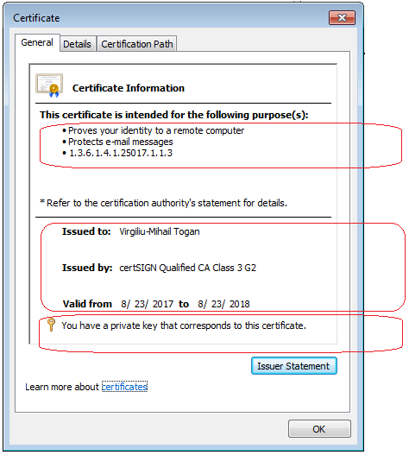
Digital certificates
There are several categories of information:
The main scope of certificate
The SUBJECT of certificate
The ISSUER of certificate
The validity of certificate
If there is a registered
private-key, pairing with this public key

Slide 41
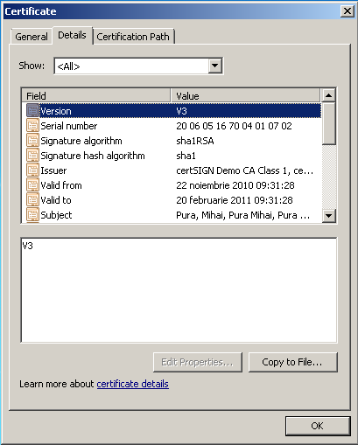
Digital certificates

Slide 42
Digital certificates
Extensions
The scope of the certificate, usage policies, constraints, etc.
X.509 v3 standard extensions
1. key information
authority key identifier
subject key identifier
key usage
private key usage period
2. policy information
certificate policies
policy mappings

Slide 43
Digital certificates
Extensions
X.509 v3 standard extensions
3. user and CA attributes
subject alternative name
issuer alternative name
subject directory attributes
4. certification path constraints
basic constraints
name constraints
policy constraints

Slide 44
Digital certificates
Extensions
Authority key identifier extension contains a key identifier, if not necessary the issuer name and the serial number
CRL distribution points extension contains the location where CRL may be found
Authority information access extension contains the repository in which the own CA certificate may be found

Slide 45
Digital certificates
End-entity certificates
Are issued to subjects that are not CAs
Contain public keys used for verifying digital signatures or for performing key management
Subject:
human user
system (Web server or router)
two types:
User certificates
System certificates

Slide 46
Digital certificates
CA certificates
Are issued to subjects that are CAs
Are part of certificate paths
Contain public keys used for
verifying digital signatures on certificates and CRLs
Must contain sufficient information for certificate users to construct certification paths and locate CRLs

Slide 47
Digital certificates
CA certificates
Subject:
other CA in the same enterprise
a CA in other enterprise
a bridge
three types
CA certificates within an enterprise PKI
CA certificates between enterprise PKIs
CA certificates in a Bridge CA Environment

Slide 48
Digital certificates
Self-signed CA certificates (self-issued)
Issuer and Subject are the same
Used to
establish trust points
distribute a new signing public key
modify the certificate policies supported in a PKI

Slide 49
ASN.1
ASN.1 - Abstract Syntax Notation One
a standard and notation that describes
rules
and structures
for representing, encoding, transmitting, and decoding data in telecommunications and computer networking
ASN.1 decoder:
https://holtstrom.com/michael/tools/asn1decoder.php
http://phpseclib.sourceforge.net/x509/asn1parse.php
https://lapo.it/asn1js/
Object Identifier (OID) Repository
http://www.oid-info.com/

Slide 50
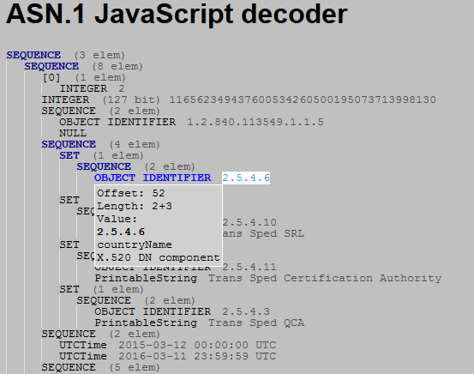
Digital certificates – ASN.1

Slide 51
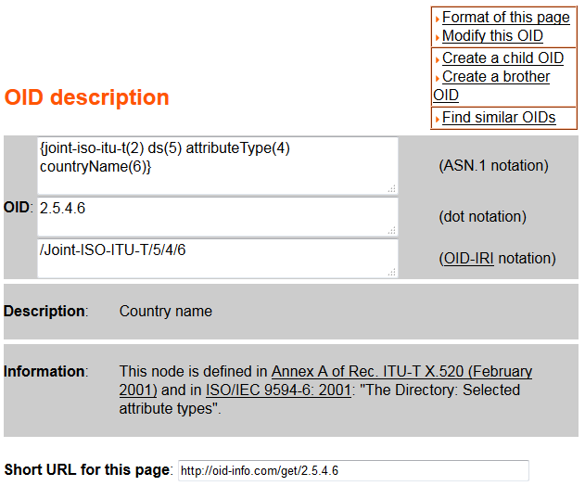
Digital certificates – ASN.1

Slide 52
Certification Path
CA’s digital signature on the certificate
is the guaranty that the digital certificate is owned by the person whose identification information are contained in it
To verify the bond between the public key and the identity of the owner
verify the signature of the CA over the certificate
The digital certificate of the issuer (a CA) is needed

Slide 53
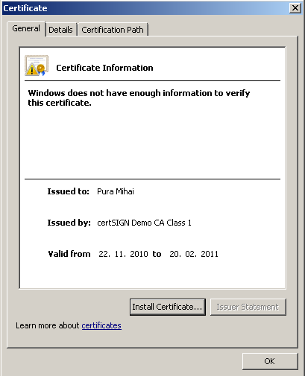
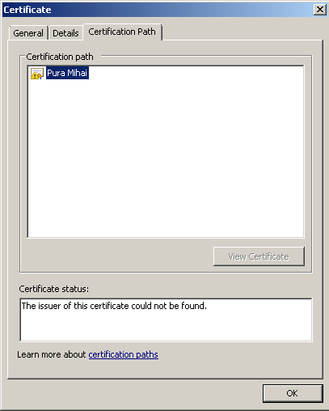
Certification Path

Slide 54
Certification Path
Certification path
all the digital certificates needed to verify someone's digital certificate
each certificate has a certification path starting from a ROOT-CA
usually, Root-CA certificate is a trusted point in the system
The root certificate for this path is a self-signed certificate
The self-signed certificate cannot be further validated
So another verification element is added: the trust in a CA

Slide 55
Certification Path
If a CA is trusted it does not matter that it had sign its own certificate
If a CA is not trusted, the user will be informed about it
The digital certificates of a CA can be downloaded from their web site

Slide 56
Certification Path
An ordered sequence of certificates between
the end entity
and the trusted point in the hierarchy (Root-CA)
The result is a certificate chain that
begins at the end entity
and ends at the Root-CA

Slide 57
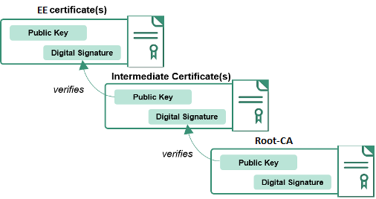
Certification Path

Slide 58

Certification Path

Slide 59
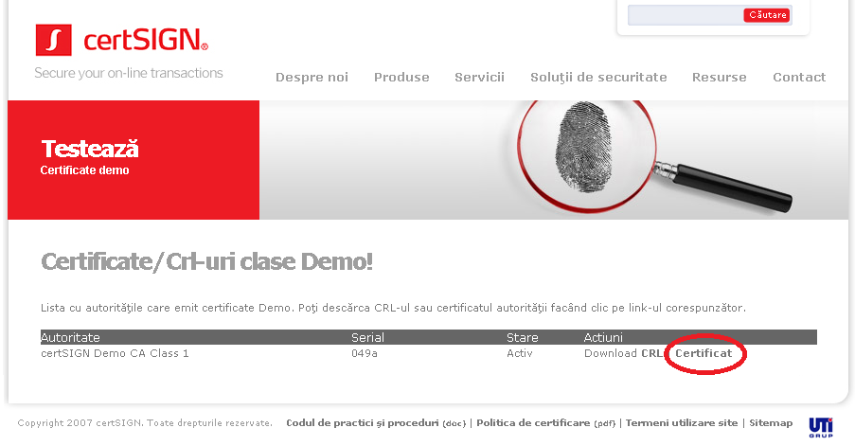
Certification Path

Slide 60
Certificate stores
Microsoft Windows operating systems manages digital certificates through special store places
certificate stores
To execute operations over these stores, the Certificates snap-in should be used
Start, Run: certmgr.msc

Slide 61
MS Windows certificate stores
A system store
a collection that consists of one or more physical sibling stores
for each system store, there are predefined physical sibling stores
All certificates in those physical stores are available through the logical system store collection
For each system store location, the predefined systems stores are: MY, Root, Trust, CA
In CERT_SYSTEM_STORE_CURRENT_USER, there is also a predefined UserDS store. A smart card store is planned for this location

Slide 62
MS Windows certificate stores
The system stores:
CERT_SYSTEM_STORE_CURRENT_USER
CERT_SYSTEM_STORE_LOCAL_MACHINE
CERT_SYSTEM_STORE_CURRENT_SERVICE
CERT_SYSTEM_STORE_SERVICES
CERT_SYSTEM_STORE_USERS
CERT_SYSTEM_CURRENT_USER_GROUP_POLICY
CERT_SYSTEM_LOCAL_MACHINE_GROUP_POLICY
CERT_SYSTEM_STORE_LOCAL_MACHINE_ENTERPRISE

Slide 63
MS Windows certificate stores
CERT_SYSTEM_STORE_CURRENT_USER system stores are at the following registry location:
HKEY_CURRENT_USER
Software
Microsoft
SystemCertificates
The predefined physical stores associated with those system stores are as follows
http://msdn.microsoft.com/en-us/library/windows/desktop/aa388136%28v=vs.85%29.aspx

Slide 64
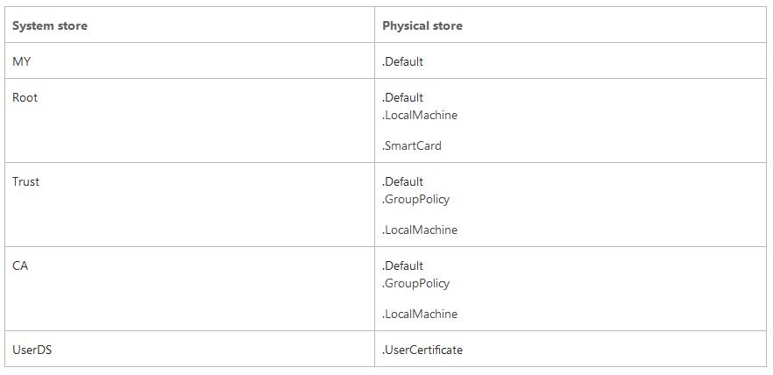
MS Windows certificate stores

Slide 65
Create MMC snap-in to manage certificate stores
1. Run "mmc.exe" from a command line window. A blank Console window shows up.
2. Click "Add/Remove Snap-in" from the "File" menu. The "Add/Remove Snap-in" dialog box shows up.
3. Click the "Add" button. A list of "Available standalone snap-ins" shows up.

Slide 66
Create MMC snap-in to manage certificate stores
4. Select "Certificates" and click "Add". The "Certificates snap-in" options dialog box shows up.
5. Select "Computer account" and click "Next". The "Select Computer" dialog box shows up.
6. Select "Local computer" and click "Finish". The "Certificates" snap-in is added.

Slide 67
Create MMC snap-in to manage certificate stores
7. Close the "Available standalone snap-ins" list dialog box.
8. Click "OK" on the "Add/Remove Snap-in" dialog box to accept the new snap-in.
9. Click "Save" from the "File" menu. The "Save As" dialog box shows up.
10. Enter "MyCertificatesConsole.msc" as the file name and click "Save".

Slide 68
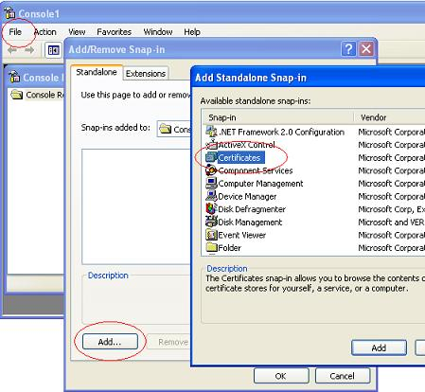
Create MMC snap-in to manage certificate stores

Slide 69
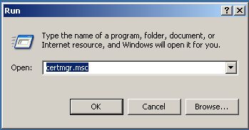
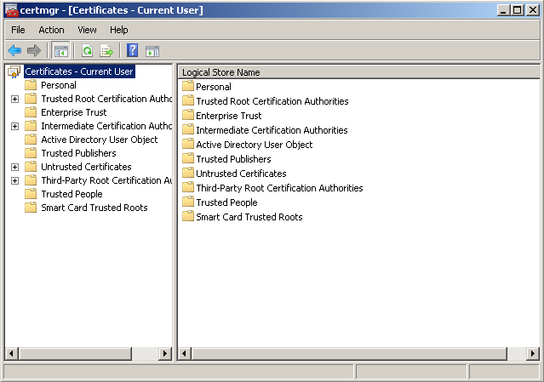
MS Windows certificate stores

Slide 70
MS Windows certificate stores
Personal
stores all the certificates for which the current user has the corresponding private keys:
certificates issued for the current user
for that computer
or for a service that runs on it

Slide 71
MS Windows certificate stores
Trusted Root Certification Authorities
stores the digital certificates of the CAs that are implicit trusted
Trusted People
stores certificates issued for persons or entities that are trusted

Slide 72
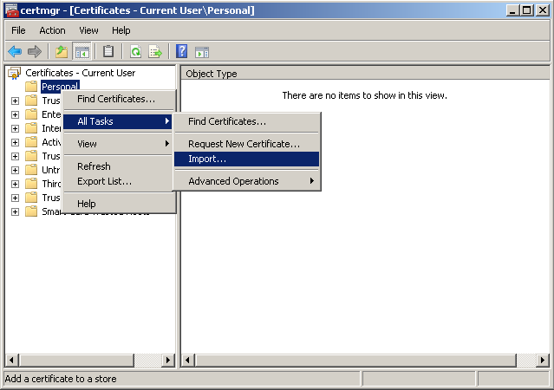
Certificate import

Slide 73
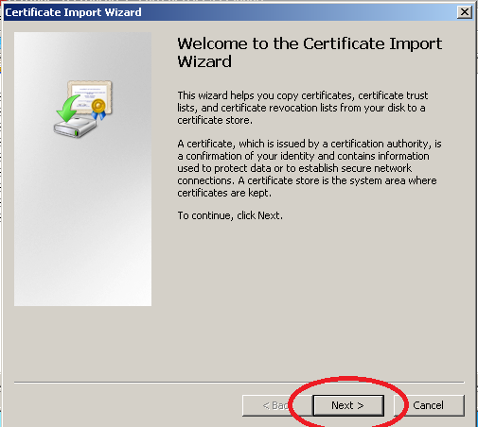
Certificate import

Slide 74
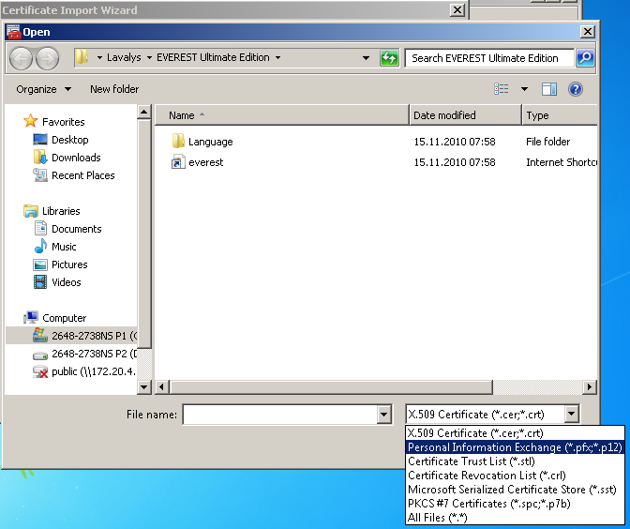
Certificate import

Slide 75
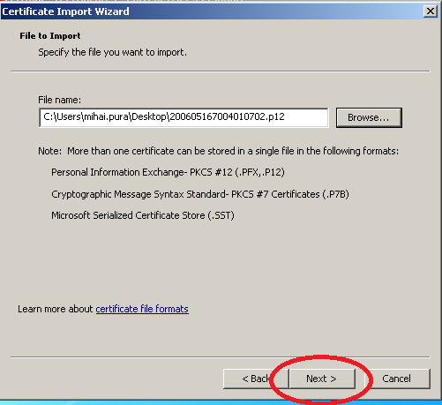
Certificate import

Slide 76
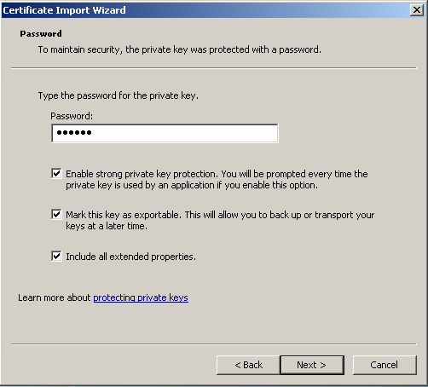
Certificate import

Slide 77
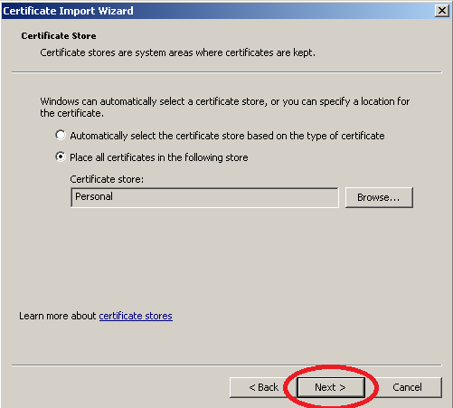
Certificate import

Slide 78
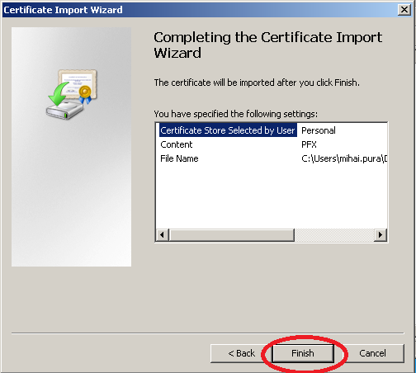
Certificate import

Slide 79
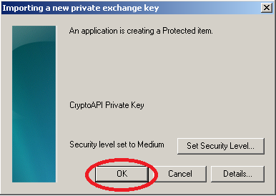
Certificate import

Slide 80
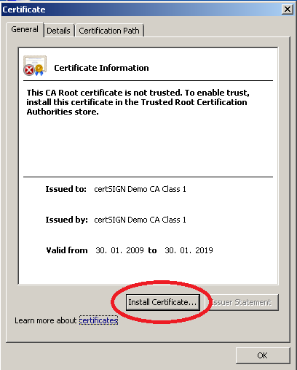
Certificate import for the CA

Slide 81
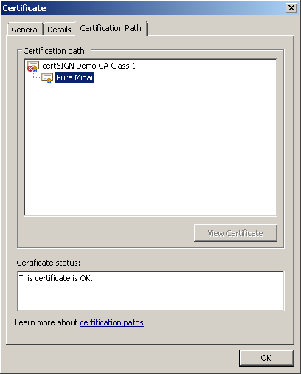
Certification Path

Slide 82
Certification Path
To mark the CA as trusted
its digital certificates should be imported to the Trusted Root Certification Authorities store

Slide 83
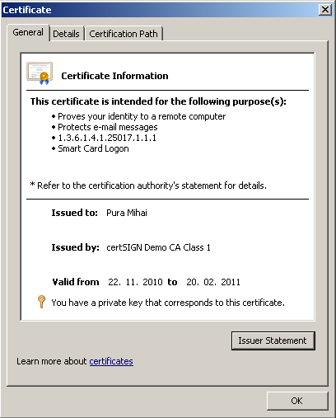
Certification Path

Slide 84

Certificate search

Slide 85
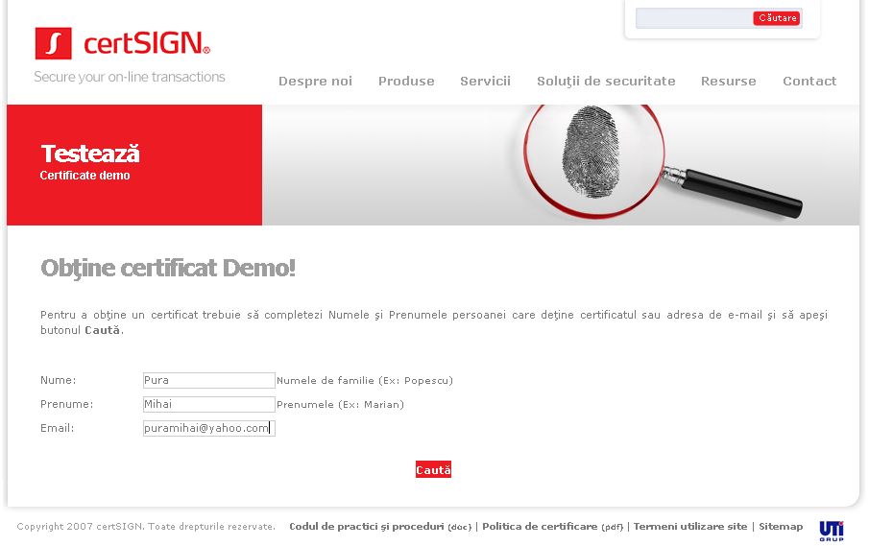
Certificate search

Slide 86
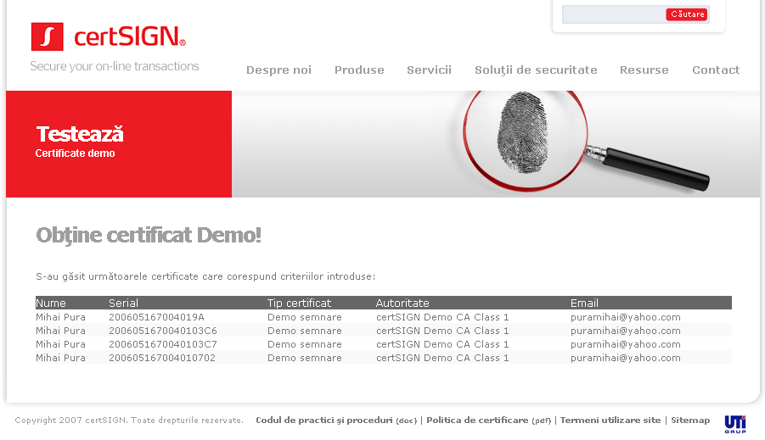
Certificate search

Slide 87
Certificate search - LDAP
LDAP – Lightweight Directory Access Protocol
application protocol for querying and modifying data of directory services implemented in Internet Protocol networks
A directory is a set of objects with attributes organized logically in a hierarchical manner
Exemplificare
Softerra LDAP Browser
http://www.ldapbrowser.com/download.htm

Slide 88
LDAP
RFC 2587 - Internet X.509 Public Key Infrastructure LDAPv2 Schema
https://www.ietf.org/rfc/rfc2587.txt
defines the attributes and object classes to be supported by an LDAP CR server
RFC 2559 - Internet X.509 Public Key Infrastructure Operational Protocols - LDAPv2
https://tools.ietf.org/html/rfc2559
defines the access method to a repository with which an End-Entity or a CA can retrieve or modify the certificate and CRL information stored in a CR

Slide 89
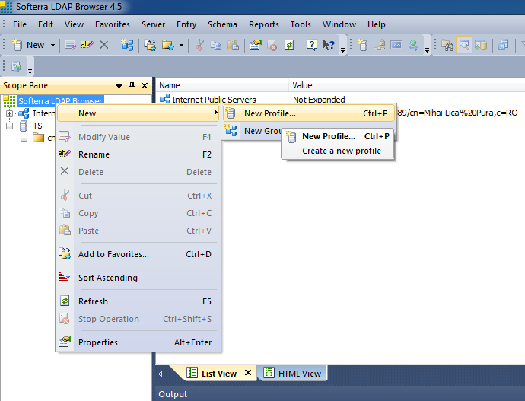
Softerra LDAP Browser

Slide 90
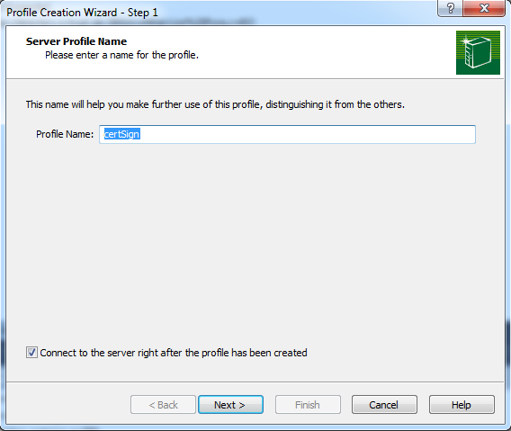
Softerra LDAP Browser

Slide 91
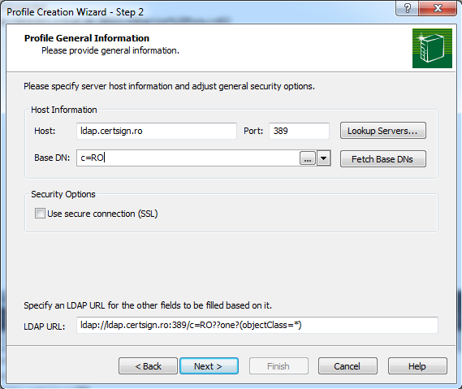
Softerra LDAP Browser

Slide 92
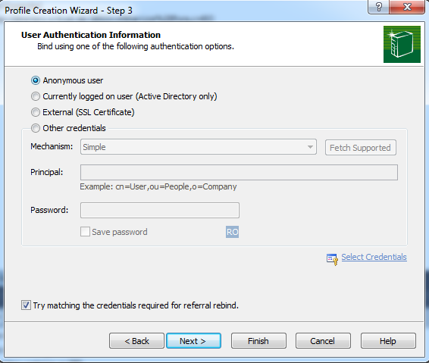
LDAP – search for and save a digital certificate

Slide 93
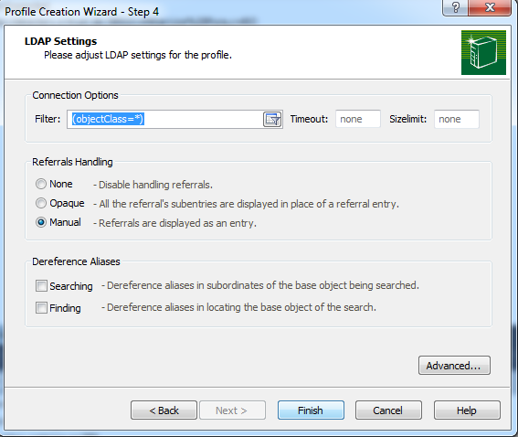
LDAP – search for and save a digital certificate

Slide 94
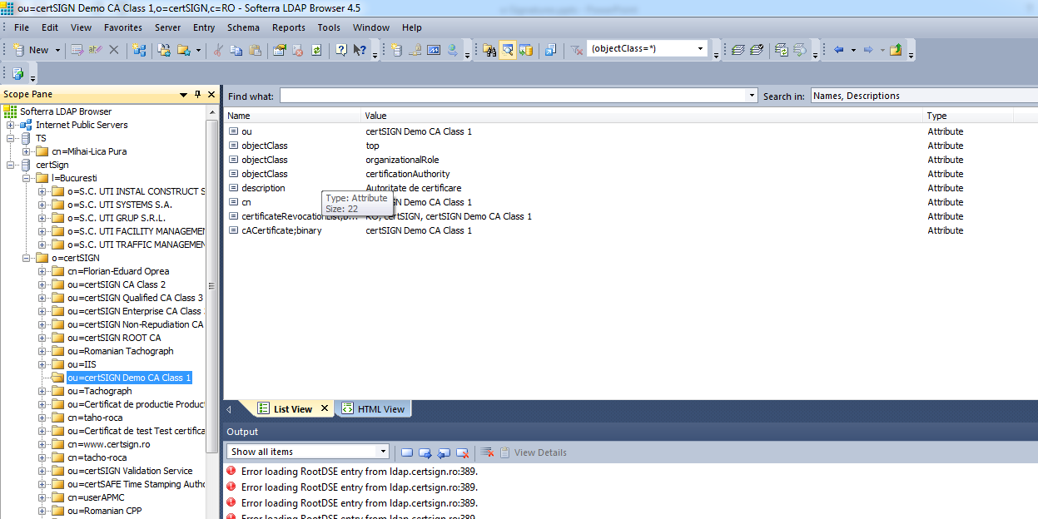
LDAP – search for and save a digital certificate

Slide 95
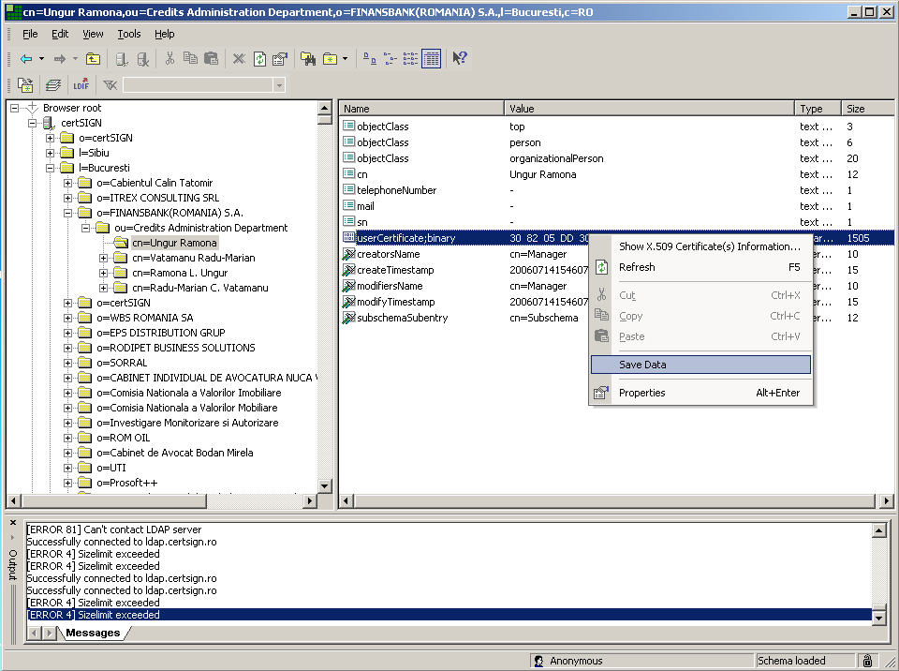
LDAP – search for and save a digital certificate

Slide 96
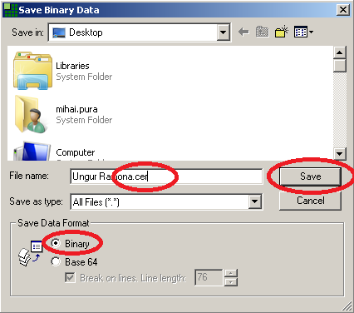
LDAP – search for and save a digital certificate

Slide 97
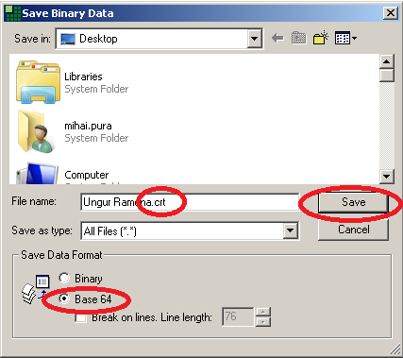
LDAP – search for and save a digital certificate

Slide 98
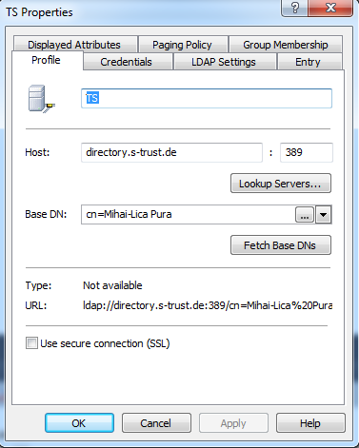
Trans Sped LDAP Server
ldap://directory.s-trust.de

Slide 99
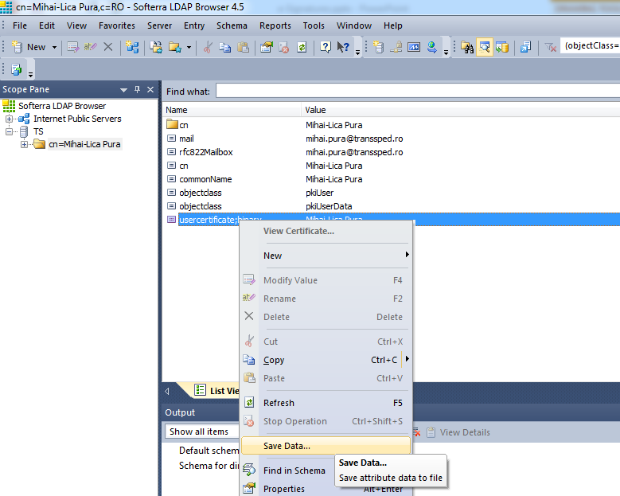
Trans Sped LDAP Server

Slide 100
Certificate revocation
A certificate must be revoked when
the private key pair is compromised
the private key pair is lost
the person leaves the company
All users know to no longer trust in the revoked certificates
The CA makes available the revocation information for the certificates it has issued
CRL - Certificate Revocation List
OCSP – Online Certificate Status Protocol

Slide 101

Certificate revocation

Slide 102

Certificate revocation

Slide 103
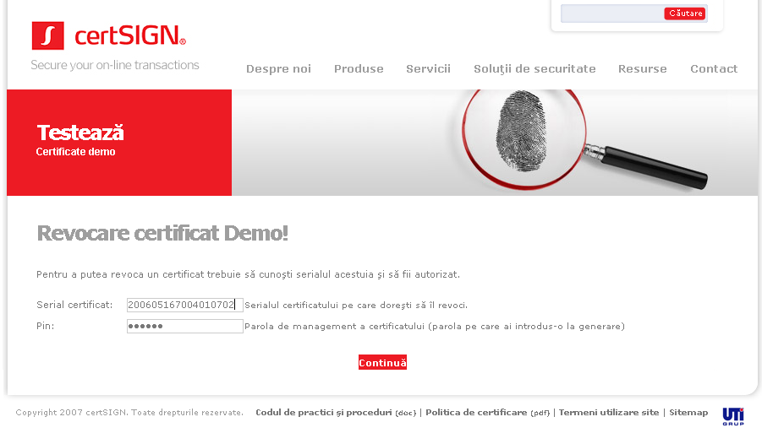
Certificate revocation
Numărul serial al certificatului:
- trebuie să fie exact în forma în care a fost scris în fereastra de la emiterea certificatului din care am descărcat fișierul P12
- trebuie scris cu majuscule (pentru cifrele hexazecimale A, B, C, D, E, F) şi fără spaţii

Slide 104
Certificate Revocation List
contains a list of serial numbers for the certificates that were revoked by the CA
the information contained in the CRL is digitally signed by the issuing CA
the CRLs are made public by the CA and can be downloaded usually from a web site

Slide 105
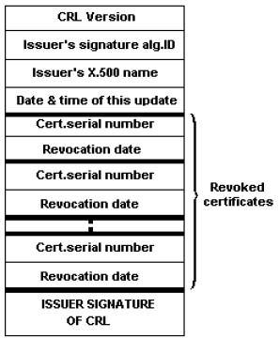
Certificate Revocation List

Slide 106
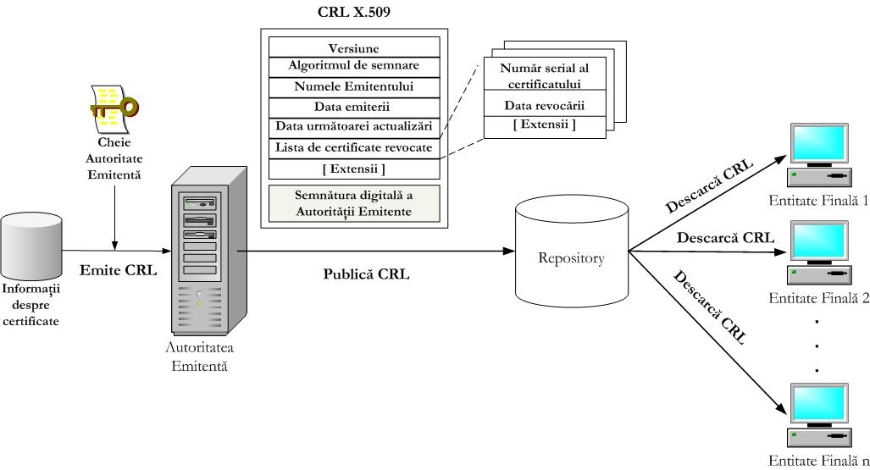
Certificate Revocation List

Slide 107
Certificate Revocation List
To check if a certificate has been revoked
look for its serial number in the list from the CRL
if the serial number is found in the CRL, than the certificate has been revoked
otherwise, the certificate has not been revoked

Slide 108
Certificate Revocation List
Relaying parties check CRL before using a certificate
Caching a CRL in a local cache
Rather than one long CRL, keep multiple shorter CRLs

Slide 109

Certificate Revocation List

Slide 110
Certificate Revocation List
Distribute the CRL to multiple places and spread the load using the certificate extension field cRLDistributionPoints
Use a sufficiently scalable and powerful CR server

Slide 111

Certificate Revocation List

Slide 112

Certificate Revocation List

Slide 113


Certificate Revocation List

Slide 114
Import CRL into certificate store
The same way a digital certificate is imported

Slide 115
OCSP
RFC 6960 - X.509 Internet Public Key Infrastructure Online Certificate Status Protocol - OCSP
https://tools.ietf.org/html/rfc6960
Inquires issuing CA whether a certificate is still valid
Response: YES/NO
http://www.openssl.org/docs/apps/ocsp.html

Slide 116

OCSP

Slide 117
Verify revocation status with openssl
openssl can be downloaded from
http://gnuwin32.sourceforge.net/packages/openssl.htm
The command for OCSP validation of a certificate stored in user.crt is:
openssl ocsp –issuer CA.crt –cert user.crt –url http://ocsp.certsign.ro –noverify -text
CA certificate and the certificate that needs to be validated must be in PEM (BASE64) format.

Slide 118

Verify revocation status with openssl

Slide 119

Verify revocation status with CertUtil
certutil -url path\user.cer

Slide 120
Certificate validation
Certificate validation
verify certificate information (expiration, scope, policies, etc.)
Path validation
verify certificate’s signature using issuer CA public-key (from CA’s certificate)
Status validation
verify revocation status using issuer CA’s CRL/OCSP

Slide 121

Certificate validation

Slide 122
Free/Open source CA
https://www.ejbca.org/
https://www.dogtagpki.org/
http://simpleauthority.com/
http://www.cacert.org/
the URL for source code download can be found at About CACert.org
https://letsencrypt.org/

Slide 123
PKI in the real world
Document signing
Signatures with legal value
Email encryption & signing (S/MIME)
Transport-layer VPNs (using SSL)
Network-layer VPNs (using IPSec)
Web servers authentication (HTTPS)

Slide 124
PKI in the real world
Web servers & Client mutual authentication (HTTPS)
TCP servers & Clients authentication (SSL)
User authentication to services (databases, etc.)
Network/IT Infrastructure services access (smartcard logon)
…

Slide 125
Electronic signature vs. digital signature
Electronic signatures:
legal concept that captures
intent
and consent
can be anything, from a scripted text, click-to-sign, image or voice image that illustrates an action of consent
Digital signatures: It's the mechanism that secures documents with cryptography
https://security.stackexchange.com/questions/17554/what-is-the-difference-between-an-electronic-signature-and-a-digital-signature

Slide 126
Electronic signature vs. digital signature
Are electronic signatures (according to the above definition) legally binding?
There is no absolute answer, because it depends of the national regulations
e.g. U.S.A.
https://www.globalsign.com/en/blog/electronic-signatures-vs-digital-signatures/

Slide 127
E-signature vs. e-seal
According to eIDAS (EU regulation 2014/910)
https://ec.europa.eu/digital-single-market/en/trust-services-and-eid
e-seal
Created by a legal person (e.g. an organization)
Without any human interaction (automatically)
e-signature
Created by a natural person (e.g. a human person)
The person adding the signature performs some action for this operation
The person is authenticated

Slide 128
The use of digital signatures
1. Signing digital documents
PDF
XML
Any other kind of files (PKCS#7)
2. Certificate login
3. Code signing
Java Web Start applications
Microsoft Office macros
Microsoft software installation packages

Slide 129
The use of digital signatures
ANAF
Annual financial reports
https://static.anaf.ro/static/10/Anaf/Declaratii_R/instructiuni/etape_depunere.htm
https://static.anaf.ro/static/10/Anaf/Declaratii_R/instructiuni/Instructiuni_D200.htm
CNAS
Reports of medics and pharmacists
http://www.cnas.ro/casmb/page/procedura-de-inregistrare-a-certificatelor-digitale.html
UNNPR

Slide 130
The use of digital signatures
MySMIS 2014
Access EU funds – Ministry of European Funds
https://2014.mysmis.ro/
http://www.fonduri-ue.ro/mysmis
SEAP (Sistemul Electronic de Achiziții Publice)
http://licitatiiseap.ro/seap/
https://www.e-licitatie.ro/
ITM (Inspectoratul Teritorial al Muncii)
Monitorul Oficial
ONRC (Oficiul Național al Registrului Comerțului)
etc.

Slide 131

Performing a digital signature (local)

Slide 132

Performing a digital signature (cloud/remote/mobile/server)

Slide 133
Digital signatures and PDF files
Adobe Acrobat Reader DC
http://get.adobe.com/reader/?promoid=KLXME
Previously, a PDF document could be signed only with Adobe Acrobat Professional
Starting with Adobe Acrobat Reader X, signing can now be done from the reader

Slide 134

Sign a PDF file

Slide 135

Sign a PDF file

Slide 136

Sign a PDF file

Slide 137

Sign a PDF file

Slide 138

Sign a PDF file

Slide 139

Sign a PDF file
Close and then reopen Certificate Viewer

Slide 140

Sign a PDF file

Slide 141

Sign a PDF file

Slide 142

Sign a PDF file

Slide 143

Sign a PDF file

Slide 144

Verify signatures from a PDF file

Slide 145

Verify signatures from a PDF file

Slide 146

Verify signatures from a PDF file

Slide 147

Verify signatures from a PDF file

Slide 148

Verify signatures from a PDF file

Slide 149
Timestamps
TSA – Timestamp Authority (trusted party)
applies timestamps to documents
Allows a client to prove at a later date that some datum existed before a particular time
e.g. an electronic signature on a document existed before a particular time
Usually used to add a timestamp-attribute to a digital signature

Slide 150

Timestamps

Slide 151
Timestamps
Free timestamp test servers:
http://clepsydre.edelweb.fr/dvcs/service-tsp
http://time.certum.pl/
http://timestamping.edelweb.fr/service/tsp
http://www.edelweb.fr/cgi-bin/service-tsp
http://tsa.safecreative.org/
https://freetsa.org/tsr
https://opentimestamps.org/

Slide 152
Timestamps
Internet X.509 Public Key Infrastructure Time-Stamp Protocol (TSP)
RFC 3161
https://www.ietf.org/rfc/rfc3161.txt
Policy Requirements for Time-Stamping Authorities (TSAs)
RFC 3628
https://tools.ietf.org/html/rfc3628

Slide 153
Timestamps
RFC 3628
https://tools.ietf.org/html/rfc3628#section-5.1
NOTE 1:
Without additional measures the relying party may not be able to ensure the validity of a time-stamp token beyond the end of the validity period of the supporting certificate.
See Annex C on verification of the validity of a time-stamp token beyond the validity period of the TSU's certificate.

Slide 154

Time stamp a PDF file

Slide 155

Time stamp a PDF file

Slide 156

Time stamp a PDF file

Slide 157

Time stamp a PDF file

Slide 158

Time stamp a PDF file

Slide 159

Verify a timestamp from a PDF file

Slide 160

Verify a timestamp from a PDF file

Slide 161

Verify a timestamp from a PDF file

Slide 162

Verify a timestamp from a PDF file

Slide 163

Verify a timestamp from a PDF file
Close dialog box and revalidate signature

Slide 164

Sign and timestamp a PDF file
After configuring a time stamp server, every digital signature that will be created will be time stamped.

Slide 165

Timestamped URL screenshot
https://freetsa.org/index_en.php

Slide 166

PDF signatures

Slide 167

Using LDAP for searching certificates

Slide 168

Sign Microsoft Office Documents

Slide 169

Sign Microsoft Office Documents

Slide 170

Sign Microsoft Office Documents

Slide 171

Sign Microsoft Office Documents

Slide 172
Sign Microsoft Office Documents
The same steps apply for:
Microsoft PowerPoint
Microsoft Excel

Slide 173
Sign/Verify any kind of file
Exercise scenarios:
1. Signing with an expired certificate
2. Signing with a revoked certificate
3. Signing with a valid certificate
4. Verifying signatures obtained from 1, 2 and 3

Slide 174
Sign/Verify any kind of file
Exercise scenarios:
5. Verifying a signature after the certificate has expired
certificate was valid at the moment of signing
6. Verifying a signature after the certificate was revoked
certificate was valid at the moment of signing

Slide 175
Sign/Verify any kind of file
7. Signing with a timestamp for the document
8. Signing with a timestamp for the signature
9. Cosigning a signed file
10. Signing with a detached signature
11. Signing a PDF file (ProSigner)
12. Signing Microsoft Office files: docx, xlsx, pptx (ProSigner)

Slide 176
Sign/Verify any kind of file
13. Encrypting a file for a recipient
14. Encrypting a file for multiple recipients
15. Decrypting a file
16. Sign a file, then encrypt it for one or more recipients
17. Decrypt an encrypted file, then verify signature

Slide 177
Sign/Verify any kind of file
PKCS #7: Cryptographic Message Syntax Standard
http://www.rsa.com/rsalabs/node.asp?id=2129
ASN.1 compiler
https://holtstrom.com/michael/tools/asn1decoder.php
http://phpseclib.sourceforge.net/x509/asn1parse.php
http://lionet.info/asn1c/asn1c.cgi

Slide 178
Sign/Verify any kind of file
DeskSeal
Attached/Detached Signatures
Time stamp signature
Co signatures

Slide 179
Sign/Verify any kind of file
ProSigner
LDAP configuration
LDAP over SSL
OCSP configuration
Signing validation request
Verify OCSP server response
PDF signing configuration
Add a background image to the signature

Slide 180

PKCS#7 signatures

Slide 181

PKCS#7 signatures

Slide 182
Sign/verify XML files (XMLDSig)
XMLDSig specification
http://www.w3.org/TR/xmldsig-core/
XML Signer
https://www.signfiles.com/xml-signer/
Signs XML files (XML Signer)
And verifies XML signatures (XML Signer Viewer)
Sample XML file to sign
https://www.w3schools.com/xml/note.xml

Slide 183

Sign/verify XML files (XMLDSig)
https://www.xml.com/pub/a/2001/08/08/xmldsig.html

Slide 184
Sign/verify XML files (XMLDSig)
Determine which resources are to be signed
will take the form of identifying the resources through a Uniform Resource Identifier (URI)

Slide 185
Sign/verify XML files (XMLDSig)
Calculate the digest of each resource
each referenced resource is specified through
a <Reference> element
and its digest
(calculated on the identified resource and not the <Reference> element itself)
placed in a <DigestValue> child element like
If reference URI is “” it refers the content of the current XML document
The <DigestMethod> element identifies the algorithm used to calculate the digest

Slide 186
Sign/verify XML files (XMLDSig)
Collect the Reference elements
Collect the <Reference> elements (with their associated digests) within a <SignedInfo> element like
The <CanonicalizationMethod> element indicates the algorithm was used to canonize the <SignedInfo> element
Different data streams with the same XML information set may have different textual representations, e.g. differing as to whitespace

Slide 187
Sign/verify XML files (XMLDSig)
Collect the Reference elements
To help prevent inaccurate verification results, XML information sets must first be canonized before extracting their bit representation for signature processing
The <SignatureMethod> element identifies the algorithm used to produce the signature value

Slide 188
Sign/verify XML files (XMLDSig)
Signing
Calculate the digest of the <SignedInfo> element, sign that digest and put the signature value in a <SignatureValue> element
Add key information
If keying information is to be included, it will be placed in a <KeyInfo> element
Here the keying information contains the X.509 certificate for the sender, which would include the public key needed for signature verification

Slide 189
Sign/verify XML files (XMLDSig)
Enclose in a Signature element
Place the
<SignedInfo>
<SignatureValue>,
<KeyInfo>
into a <Signature> element
The <Signature> element comprises the XML signature

Slide 190
Signature expiration
What is the problem?
Exercises using Adobe Acrobat Reader DC

Slide 191
Signature expiration
User A
signs his document using a signature scheme
applies to a TSA to get a timestamp on the signature
User B can do the User A’s signature validation
this involves validation of the User A’s certificate
many years later when the certificate of User A can be already expired or revoked

Slide 192
Signature expiration
The validation decision are based on the timestamp applied on the signature
The signature was made before the timestamp
The applied timestamp is considered the signing-time
Without the timestamp, the User B can not be sure about the status of the User A’s certificate at the signing-time

Slide 193
Advanced Electronic Signatures
CAdES
http://www.etsi.org/deliver/etsi_ts/101700_101799/101733/
PAdES
http://www.etsi.org/deliver/etsi_ts/102700_102799/10277801/01.01.01_60/ts_10277801v010101p.pdf
XAdES
https://portal.etsi.org/webapp/WorkProgram/Report_WorkItem.asp?WKI_ID=28064

Slide 194
Signatures with Long-Term Validation Material
Validation material
is needed to validate the signature
certificates
and revocation information
OCSP responses
and/or CRLs
is included in the signature
This signature allows the validation as long as there are no technology changes
(e.g. algorithms becomes weak)

Slide 195
Signatures with Long-Term Validation Material
Examples:
CAdES-B-LT [i.11],
XAdES-B-LT [i.14],
PAdES-B-LT [i.16]

Slide 196
Signatures providing Long Term Availability and Integrity of Validation Material
Re-compute
the hash of the originally signed document
and the signed attributes
with a specific hash algorithm
Protect
re-computed values
and previously added validation material and timestamps
with a new timestamp

Slide 197
Signatures providing Long Term Availability and Integrity of Validation Material
The original signature can be validated as long as:
the latest added timestamp can be validated
and the latest used hash-algorithm is still trustworthy
Examples:
CAdES-B-LTA [i.11], CAdES-E-A [i.12],
XAdES-B-LTA [i.14], XAdES-E-A [i.15],
PAdES-B-LTA [i.16], PAdES-E-LTV [i.17]

Slide 198
Signatures providing Long Term Availability and Integrity of Validation Material
A Signature providing
Long Term Availability
and Integrity of Validation Material
is suitable for long-term preservation

Slide 199
Signatures providing Long Term Availability and Integrity of Validation Material
Mechanism (similar for the different formats):
All the missing validation material is added
a hash is computed over the existing signature including the originally signed document
and a time-stamp is computed over the final hash computation
The time-stamp is added into the signature

Slide 200
Signatures providing Long Term Availability and Integrity of Validation Material
Mechanism (similar for the different formats):
Once a signature is already in this form, the preservation service
only considers the validity of the last archival time-stamp
e.g.
the expiration of the signing certificate of the TSU
and the trustworthiness of the cryptographic algorithms used within the time-stamp

Slide 201
Signatures providing Long Term Availability and Integrity of Validation Material
Each of the AdES formats provides levels suitable for long-term preservation
In part one of CAdES [i.11], PAdES [i.16] and XAdES [i.14] baseline levels are defined:
CAdES-B-LTA,
PAdES-B-LTA and
XAdES-B-LTA

Slide 202
Signatures providing Long Term Availability and Integrity of Validation Material
The baseline levels were designed for high interoperability.
In addition, part two of CAdES [i.12], PAdES [i.17] and XAdES [i.15] provide more general extended levels:
CAdES-E-A,
PAdES-E-LTV and
XAdES-E-A

Slide 203
Timestamp expiration
Timestamps (RFC 3161) are also signatures
they rely on certificates (the TSA certificate)
and thus they expire
also, timestamp becomes useless in the same moment as the TSA ceases operation or is compromised

Slide 204
Timestamp expiration
Solutions (PKI)
I. Use just one timestamp, but whenever the latest time stamp is about to expire
but before expiration
one needs to obtain a new timestamp computed over the previous timestamp
II. get several timestamps on one file
regularly timestamp it before any of the TSA certificates is about to expire

Slide 205
Timestamp expiration
If the TSA's private key is compromised (and thus revoked)
the time stamp signature cannot be trusted
as whoever compromised it could sign documents with old time stamps
users would want to be warned before accepting a time stamp signature from a compromised certificate

Slide 206
Timestamp expiration
Solutions
Get a signed time stamp from multiple TSAs
if any one is not revoked, that signature can still be trusted
Use threshold signing
an attacker would have to compromise a number of parties in order to forge signatures
which is much less likely than compromise of a single party

Slide 207
Timestamp expiration
https://crypto.stackexchange.com/questions/3291/signature-and-timestamp-for-long-term-document-archival-question
https://en.wikipedia.org/wiki/Trusted_timestamping

Slide 208
Advanced Electronic Signatures
Signing tools
A. web:
https://ec.europa.eu/cefdigital/DSS/webapp-demo/home
B. desktop:
http://xolidosign.en.softonic.com/
C. others:
https://www.agid.gov.it/it/piattaforme/firma-elettronica-qualificata/software-verifica

Slide 209
Certificate login
Centrul Național de Administrare a Registrelor Naționale Notariale
https://eguvernare.stsisp.ro/
https://www.infonot.eu/
https://www.cacert.org/
First install cacert CA certificate
in Trusted Root Certification Authorities (for Microsoft Edge, Microsoft Internet Explorer and Google Chrome)
or the corresponding certificate store in Mozilla Firefox
If using Google Chrome, enable certificate request generation in the browser settings

Slide 210

Code signing – Unsigned Java applets (obsolete)
http://www.cs.stir.ac.uk/~sbj/examples/Java-examples-basic/
http://www.sitepoint.com/java-applets-obsolete-still-part-web/

Slide 211

Code signing – Unsigned Java applets (obsolete)

Slide 212

Code signing – Unsigned Java applets (obsolete)

Slide 213

Code signing – Signed Java applets (obsolete)

Slide 214

Code signing – Signed Java applets (obsolete)

Slide 215

Code signing – Signed Java applets (obsolete)

Slide 216

Code signing – Signed Java applets (obsolete)

Slide 217
Code signing – Java Web Start
Java Web Start sample applications
https://docs.oracle.com/javase/tutorial/deployment/webstart/examplesIndex.html
Java certificate stores
Control Panel -> Java -> Security tab -> Manage certificates

Slide 218

Code signing – Java Web Start

Slide 219

Code signing – Java Web Start

Slide 220

Code signing – Java Web Start

Slide 221

Code signing – Java Web Start

Slide 222

Code signing - Macros

Slide 223

Code signing - Macros

Slide 224

Code signing - Macros

Slide 225
Code signing - Executables
User Account Control on Microsoft Windows 7 and greater

Slide 226
Cryptography libraries – High Level
Digital Signature Services
https://ec.europa.eu/cefdigital/wiki/display/CEFDIGITAL/Start+using+Digital+Signature+Services+%28DSS%29+-+Releases+and+Bitbucket
Bouncy Castle
https://www.bouncycastle.org/
SecureBlackbox
http://www.secureblackbox.com/#

Slide 227
Cryptography libraries – Low Level
OpenSSL
https://www.openssl.org/
MIRACL
https://github.com/miracl/MIRACL
https://libraries.docs.miracl.com/miracl-explained/what-is-miracl
libecc
https://github.com/ANSSI-FR/libecc

Slide 228
Microsoft Trusted Root Certificate Program
https://technet.microsoft.com/en-us/library/cc751157.aspx
Provides to clients a list of all the certificates of the certificate authorities that are trusted by Microsoft

Slide 229
Microsoft Trusted Root Certificate Program
Trusted Root Certification Authorities logical certificate store
is populated with all these certificates from the moment that a Windows operating system is installed
The list of the certificate authorities that Microsoft trusts is permanently updated

Slide 230
Microsoft Trusted Root Certificate Program
The update of the contents of Trusted Root Certification Authorities (automatic update):
By Internet Explorer:
every time a user
access a HTTPS site,
or opens a S/MIME e-mail message,
or downloads a signed ActiveX control,
and the operating system, in its verifications, encounters a certificate that is not present in the Trusted store
it will verify online if this certificate is on the trusted CAs list of Microsoft
and if yes, it will be downloaded in the store

Slide 231
Microsoft Trusted Root Certificate Program
For a CA to have its certificate included on the Microsoft trusted CAs list, it must:
Obtain a preliminary approval for the participation, which is granted based on some information requested by Microsoft
The CA must send a test certificate issued by its root certificate authority
The CA must then sign an agreement with Microsoft

Slide 232
Microsoft Trusted Root Certificate Program
The root certificate of the CA must have
a minimum 2048 bit length RSA key
the validity period must be at least 8 years
but it should expire before 2030
The certificates issued by the CA must
support the CRL Distribution Point extension
and the CRL distribution point must be publically accessible

Slide 233
Microsoft Trusted Root Certificate Program
The CA
must have a written certificate revocation policy
must be able to revoke any of the issued certificates
must be the subject of an annual security audit
and it must sent the results to Microsoft

Slide 234
Microsoft Trusted Root Certificate Program
Using Internet Explorer
access a HTTPS web site for which the certificate is issued by a certificate authority that has its root certificate on the Microsoft trusted CAs list
E.g.
https://ca.transsped.ro
The page will be automatically opened, like a regular HTTP web page

Slide 235

Microsoft Trusted Root Certificate Program

Slide 236

Microsoft Trusted Root Certificate Program

Slide 237

Microsoft Trusted Root Certificate Program

Slide 238

Microsoft Trusted Root Certificate Program

Slide 239

Microsoft Trusted Root Certificate Program

Slide 240

Microsoft Trusted Root Certificate Program

Slide 241

Microsoft Trusted Root Certificate Program

Slide 242
Microsoft Trusted Root Certificate Program
Using Internet Explorer
access a HTTPS web site for which the certificate is NOT issued by a certificate authority that has its root certificate on the Microsoft trusted CAs list
E.g.
https://www.cacert.org
The page will NOT be automatically opened

Slide 243

Microsoft Trusted Root Certificate Program

Slide 244

Microsoft Trusted Root Certificate Program

Slide 245

Microsoft Trusted Root Certificate Program

Slide 246

Microsoft Trusted Root Certificate Program

Slide 247

Microsoft Trusted Root Certificate Program

Slide 248
Mozilla CA Certificate Policy
https://www.mozilla.org/en-US/about/governance/policies/security-group/certs/policy/
When downloading and installing
Firefox,
Thunderbird
or other Mozilla applications
their certificate store it is populated will a list of certificates
All these certificates are marked as trusted so Firefox and Thunderbird, for example, will use them for digital signatures validation without displaying any message to the user

Slide 249
Mozilla CA Certificate Policy
As for the Microsoft Program, a CA will be included on this list after a request and a special verification process
The major differences from the Microsoft verification process are that no fees are requested, and the verification is public

Slide 250

Mozilla CA Certificate Policy

Slide 251

Mozilla CA Certificate Policy

Slide 252

Mozilla CA Certificate Policy

Slide 253

Mozilla CA Certificate Policy

Slide 254

Mozilla CA Certificate Policy

Slide 255

Mozilla CA Certificate Policy

Slide 256

Mozilla CA Certificate Policy

Slide 257

Mozilla CA Certificate Policy

Slide 258

Mozilla CA Certificate Policy

Slide 259
Legislation
Legea nr. 455/2001 privind semnătura electronică
http://www.transsped.ro/content/L_2001_07_18_455.pdf
HG 1259/2001 privind Normele tehnice şi metodologice pentru aplicarea Legii nr. 455/2001 privind semnatura electronicã
http://www.transsped.ro/content/HG_2001_12_13_1259.pdf
eIDAS Regulation no. 910/2014
https://eur-lex.europa.eu/legal-content/RO/TXT/PDF/?uri=CELEX:32014R0910&from=EN

Slide 260
Legislation
Legea nr. 451 din 1 noiembrie 2004 privind marca temporală
https://www.certsign.ro/ro/documentatie/legislatie/legea-451-2004-privind-marca-temporala
Legea nr. 589 din 15 decembrie 2004 privind regimul juridic al activităţii electronice notariale
https://www.certsign.ro/ro/documentatie/legislatie/legea-589-2004-activitate-electronica-notariala
Normele tehnice şi metodologice pentru aplicarea legii 589/2004 privind regimul juridic al activităţii electronice notariale
https://www.certsign.ro/ro/documentatie/legislatie/norme-aplicare-lege-activitate-electronica-notariala

Slide 261
Legislation
Legea 135/2007 a arhivării electronice
https://www.certsign.ro/ro/documentatie/legislatie/legea-135-2007-arhivare-electronica
Ordin MEF 858/2008 privind depunerea declaraţiilor fiscale prin mijloace electronice de transmitere la distanţă
https://www.certsign.ro/ro/documentatie/legislatie/ordin-declaratii-fiscale-online

Slide 262
Romanian CAs
AlfaSign
https://www.alfasign.ro/
certSIGN
https://www.certsign.ro/
CERT DIGITAL
https://www.certdigital.ro/
DigiSign
https://www.digisign.ro/
Trans Sped
http://www.transsped.ro/

Slide 263
References
The Value of Certificate Revocation Lists (CRLs) in a PKI
https://blogs.technet.microsoft.com/staysafe/2012/02/09/the-value-of-certificate-revocation-lists-crls-in-a-pki/
Formats of a digital signature
http://developers-club.com/posts/191866/
Introduction to XML Digital Signatures
https://flylib.com/books/en/2.329.1.75/1/

Slide 264
References
Certificate Trust
https://piv.idmanagement.gov/pivcertchains/
Windows XP: Certificate Status and Revocation Checking
https://social.technet.microsoft.com/wiki/contents/articles/4954.windows-xp-certificate-status-and-revocation-checking.aspx
Digital Signatures in a PDF
https://www.adobe.com/devnet-docs/acrobatetk/tools/DigSig/Acrobat_DigitalSignatures_in_PDF.pdf

